Slide 1



PROJECT
REPORT
A STUDY OF METROPOLITANS OF
INDIA

Slide 2

INTRODUCTION
India is the 7th largest country in the world, and the 2nd most populated country.
India is a developing State and has 4 metropolitan cities so to speak of, Delhi which is the capital city, Mumbai(formerly Bombay), Chennai(formerly Madras) and Kolkata(formerly Calcutta).
In recent years, India has seen a tremendous boost in job opportunities and the general quality of life in these metros, leading to a large rate of migration to the aforementioned cities.
These 4 cities belong to different parts of the country, and hence vary significantly in the type of life they offer.

Slide 3
PROBLEM STATEMENT
Aim to analyse the 4 metropolitans of India ; explore the neighborhoods with relevant data and state the final findings in terms of the various venues and amenities provided at each city.
Contrast and compare this data retrieved for the 4 cities on the basis of different clusters formed by the neighborhoods and the services/amenities these clusters have to offer, and how they line with the interest of the stakeholders.
Also, compare the metropolitans on the basis of different unique amenities provided by them and the corresponding quantity.
Finally, identify the different regions in each metropolitan based on shared common venues to locate possible choices for potential residents.

Slide 4
STAKEHOLDERS
A family\An individual is looking forward to migrating to one of the metropolitans for better opportunities and for a better quality of life. Which neighborhood would be the best suited for them, and why?
A business owner wants to expand to one of the metros. What are the best regions for them to open up a business to conceivable success?
How similar are metropolitan cities, even when they are located in far corners of the country?
What are the differences between a city and a nearby metropolitan, on the basis of amenities offered?

Slide 5
CONTENT
PROBLEM STATEMENT
DATA SECTION
INTRODUCTION
CONCLUSION AND
FUTURE SCOPE
METHODOLOGY
RESULTS

Slide 6
DATA ACQUISATION AND PRE PROCESSING
Data Sources
We work on 3 sets of data :-
2.1.1 Data containing the neighborhoods, pincodes,latitude, longitude and for cities in India.This data is accessed from the official government of India site,https://www.india.gov.in/ which serves as a national portal for accessing different data concerning the country of India.
To access the data set, we need to fill in a form declaring we’re using this data for academic purposes.
Unfortunately, all the latitude and longitude values were NaNs.
2.1.2 Furthermore, we found a data set containing Indian pincodes and their latitude and longitudes from the same site.
2.1.3 Based on the latitudes and longitudes in our database, we use the FourSquare API to access data about the neighborhood venues required for this study.
The Foursquare Places API provides location based experiences with diverse information about venues, users, photos, and check-ins. The API supports real time access to places.
Additionally, Foursquare allows developers to build audience segments for analysis and measurement.
JSON is the preferred response format which needs to be converted into the required dataframe
Accessing the API would require us to make an account on the Developer’s Portal on the foursquare website,https://developer.foursquare.com/
2
LOGO

Slide 7
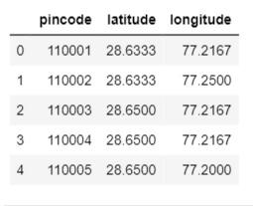
Data Cleaning
From the second database, we delete the columns of city, neighborhood and accuracy to only get the pincodes for latitudes and longitudes, for a cleaner merge.
after merging on pincode, we get the following accurate dataset. We group the neighborhoods belonging to the same pincode and region.

Slide 8
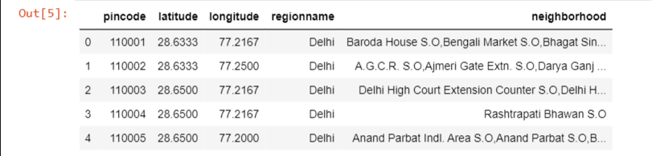
Because it is location data, there are no such outliers ; also, as the datasets have been merged on pincode which is a unique value for each region, the dataset is void of NaNs.
The foursquare data is returned as a json file. All the information is in the “items” key.
We extract the categories of the venue
We clean the json and convert it into a pandas dataframe
DESIGN
Enter subtitle
Enter subtitle

Slide 9
Feature Selection
From the dataset containing pincodes of all of India, we select the relevant ones;
The features we’ve kept are
Pincode , Latitude, Longitude,City,Neighborhood.
Which are the only ones relevant to get the necessary foursquare data for exploratory analysis of neighborhoods in a city.

Slide 10
METHODOLOGY
EXPLORATORY DATA ANALYSIS
Finding the neighborhoods in each of the metro cities,grouping them based on their pincodes and regionname and visualization the dataset obtained using using folium maps
SEGMENTATION OF DATA
Data Segmentation is the process of taking the data you hold and dividing it up and grouping similar data together based on the chosen parameters so that you can use it more efficiently
We are going to utilize the Foursquare API to explore the neighborhoods and segment them.
We get the various venues corresponding to a neighborhood. We visualise the unique venues in order to get an idea of the different types of services/amenities provided.

Slide 11
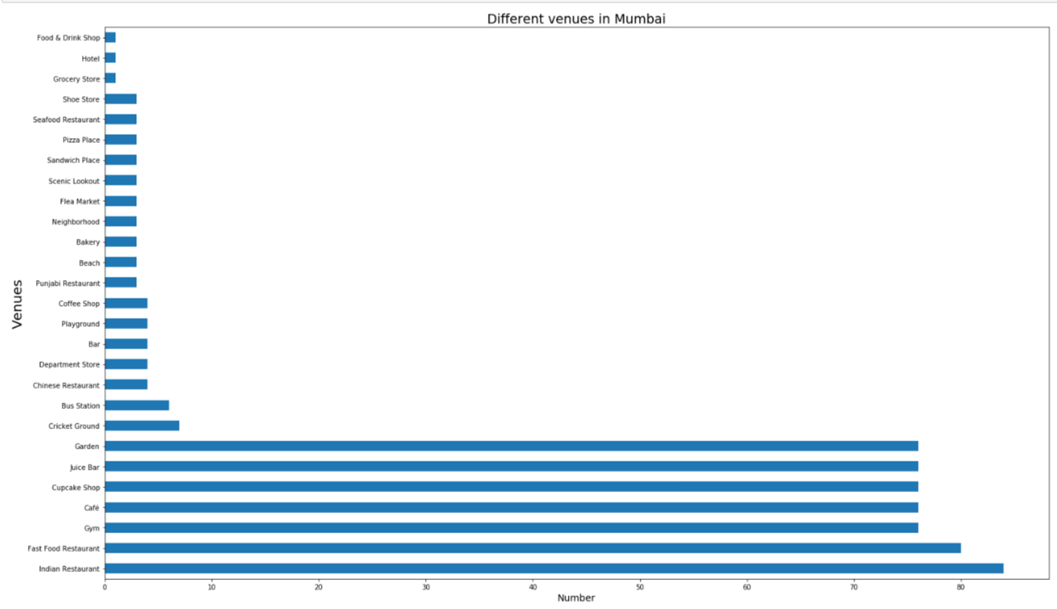
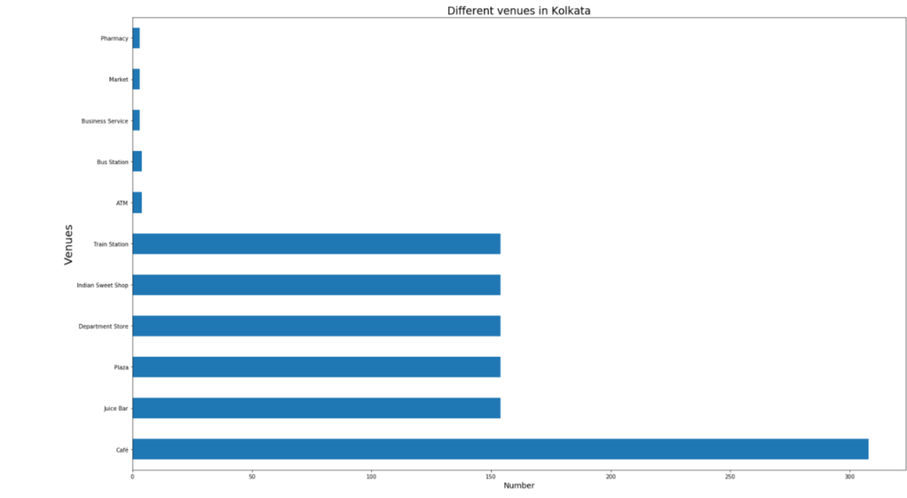
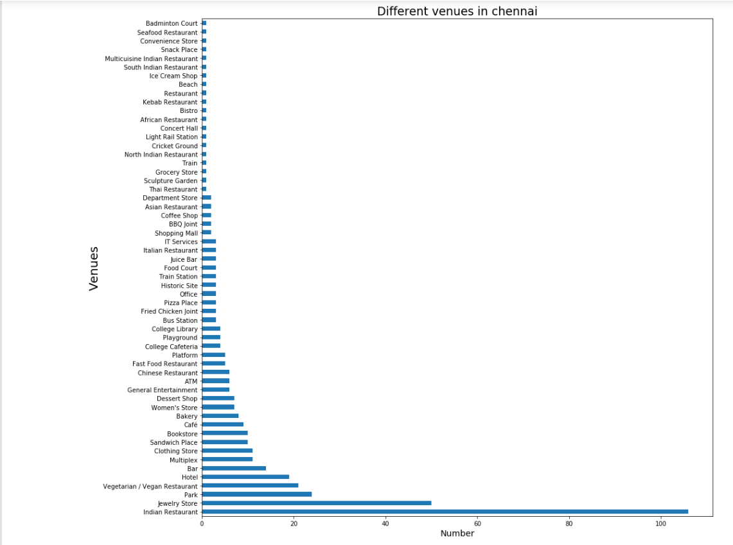
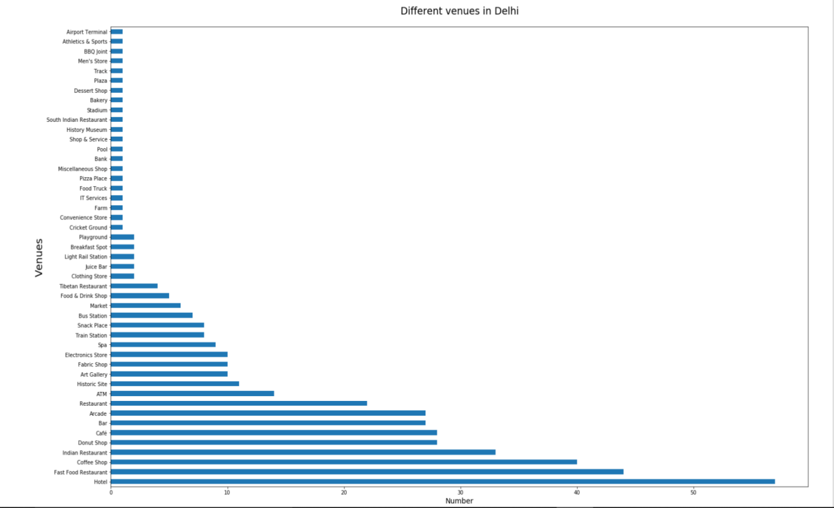

Slide 12
Next, we find out the top 10 most common venues for each neighborhood in each city.
Then we cluster the neighborhoods based on the shared common venues.
The algorithm we use is K Means clustering :It is a method of unsupervised learning. k-means clustering aims to partition n observations into k clusters in which each observation belongs to the cluster with the nearest mean, serving as a prototype of the cluster. This results in a partitioning of the data space into Voronoi cells. k-Means minimizes within-cluster variances
This algorithm is to be run on numerical data. Hence, we have to run one hot encoding
One-hot encoding is used in machine learning as a method to quantify categorical data. In short, this method produces a vector with length equal to the number of categories in the data set. If a data point belongs to the ith category then components of this vector are assigned the value 0 except for the ith component, which is assigned a value of 1. In this way one can keep track of the categories in a numerically meaningful way.
We create 5 clusters and visualize them

Slide 13
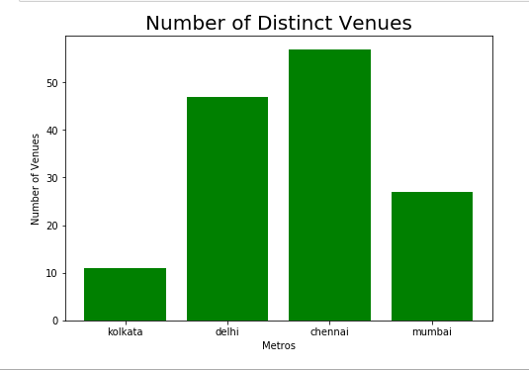
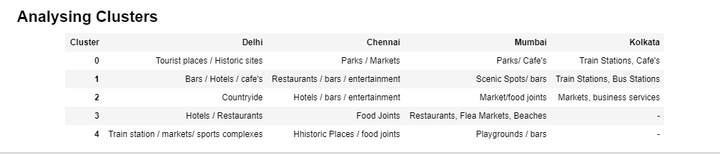

Slide 14
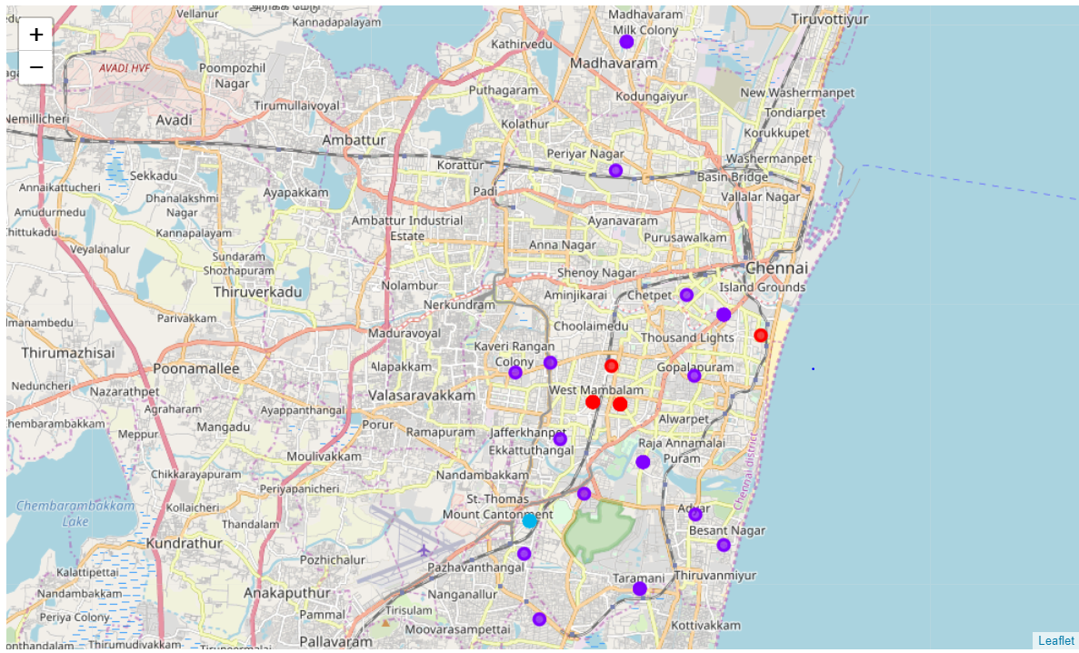
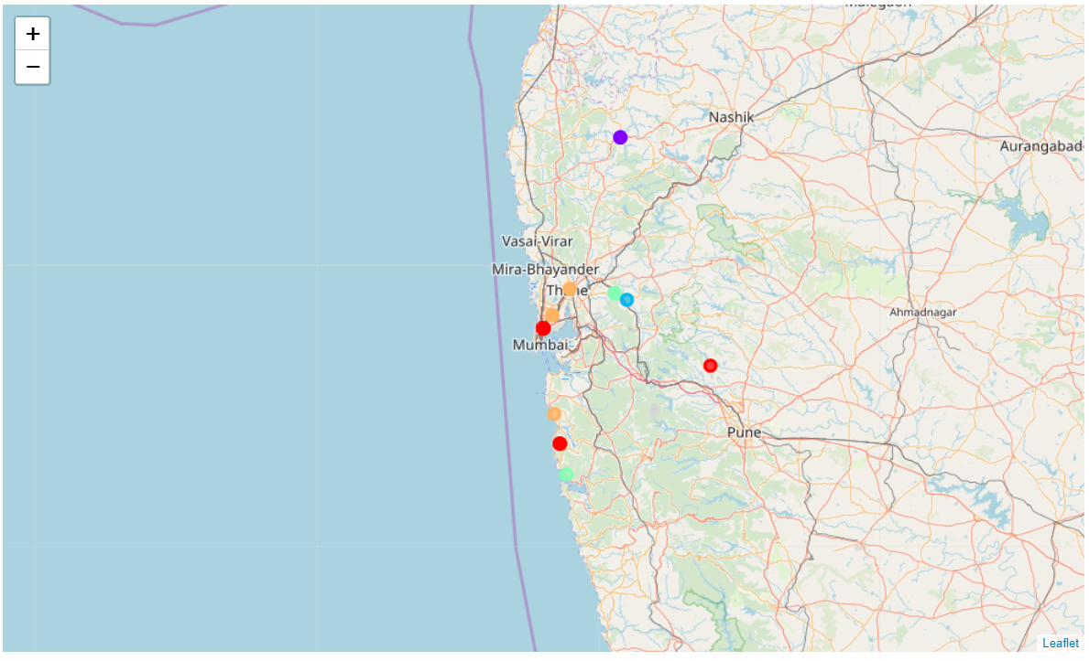

Slide 15
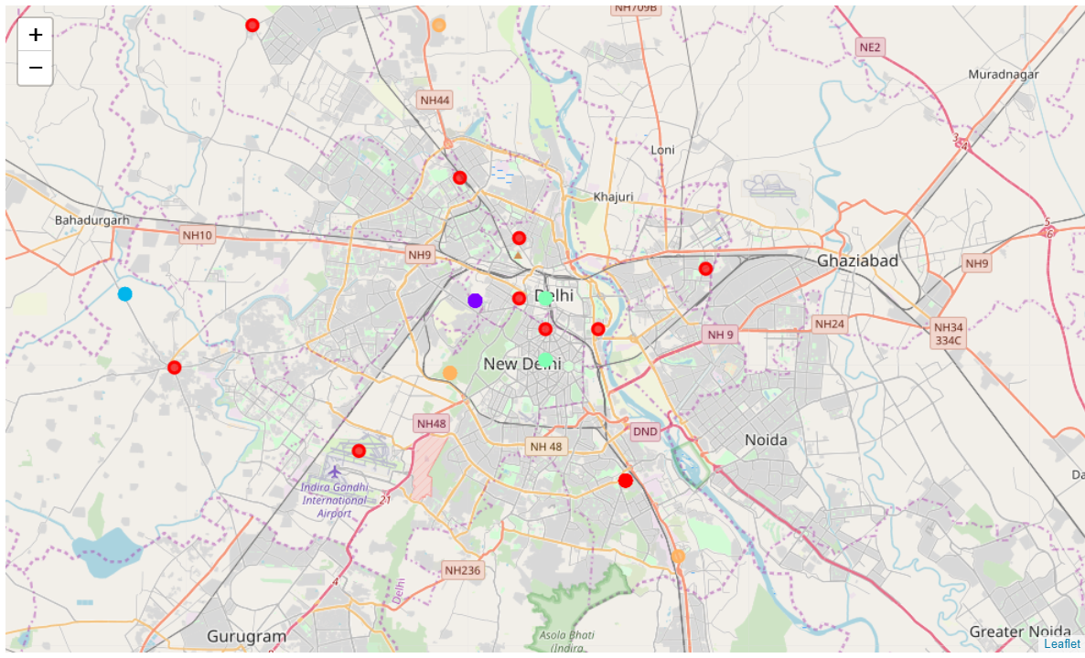

Slide 16
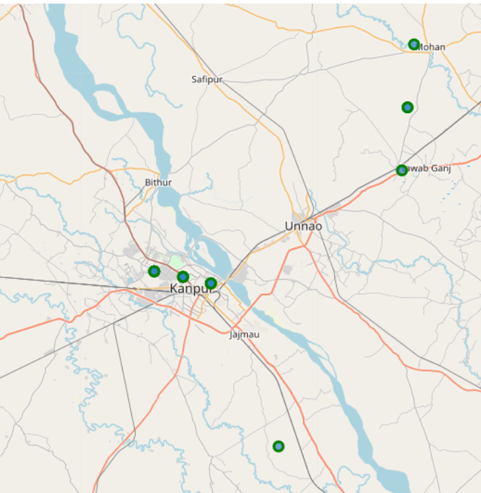
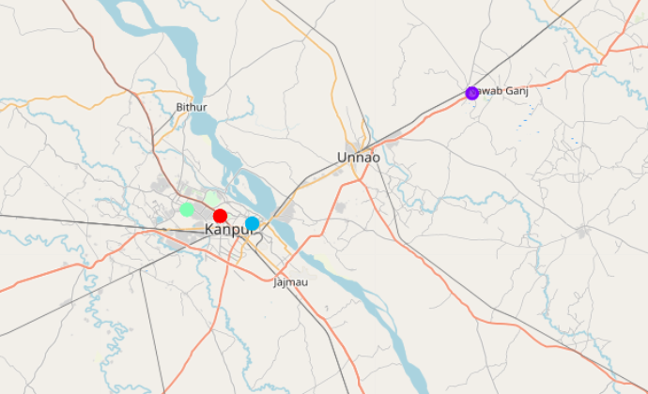
Now, we introduce a non metropolitan city, Kanpur, from the state of Uttar Pradesh
NEIGHBORHOODS CLUSTERED

Slide 17
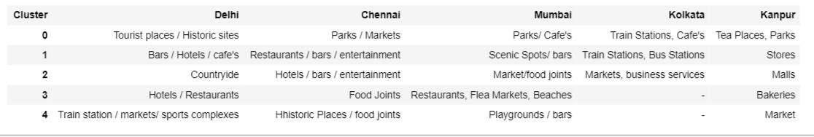
COMPARISON OF CLUSTERS WITH METROS

Slide 18
RESULTS
Chennai has the most number of distinct venues;ie, amenities and activities provided to its residents, followed by Delhi, Mumbai and Kolkata.
->Chennai has maximum number of family restaurants, jewellery stores,cafe’s and open grounds.
->Kolkata has a decent number of cafe’s
->Mumbai has maximum numbers of restaurants,bars, and general entertainment amenities
->Delhi has a plethora of fast food restaurants, hotels, bars, coffee shops and historic sites.
Kanpur,a non-metropolitan city,had a measly 21 unique venues,centred around departmental stores and malls.

Slide 19
CONCLUSION
->From the above results, we can conclude that Chennai ,Kolkata would be a good place to move in with families, whereas Mumbai and Delhi suit to bachelors more
->Chennai can be termed as the most versatile city, based on the amenities, and Kolkata, the least.
->We see that clusters in a non metro city are restricted to mundane locations like malls and stores and parks, lacking the large number of hotels,business services and entertainment services provided by metro cities. It is safe to conclude that to be a metro city, the neighborhoods must be developed to cater to the demands of high populations and giving a better quality of living through high end venues like entertainment services, bars, restaurants, and numerous business services.Also, having tourist place or a well developed IT Park gives them a boost as they have a large income of foreign travelers too, giving a boost to local businesses and job

Slide 20
->For a person moving to Chennai, neighborhoods falling in clusters 0,1,3 are good for families to settle.
Clusters 1,2,3 are good for bachelors
Clusters 0,4 are good for business owners
->For a person moving to Mumbai, neighborhoods falling in clusters 0,2,3,4 are good for families to settle.
Clusters 1,3,4 are good for bachelors
Clusters 0,1,3 are good for business owners
->For a person moving to Delhi, neighborhoods falling in clusters 2,4 are good for families to settle.
Clusters 1,4 are good for bachelors
Clusters 0,3,4 are good for business owners
->For a person moving to Kolkata, neighborhoods falling in clusters 0,1 are good to settle.
Cluster 2 is good for business owners

Slide 21
We can further add data regarding the housing prices and extra costs incurred in living certain neighborhoods for each city, in order to classify neighborhoods based on their average cost of living. This would help people in choosing the neighborhood in a particular city based on their income.
Also, we can use matching algorithms to math the features of other cities to the 4 metropolitans, studying which city is most likely to become a metropolitan in coming years. This would be good in investing purposes
SCOPE OF PROJECT

Slide 22
END
Thank you

